Slide 1
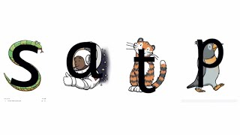
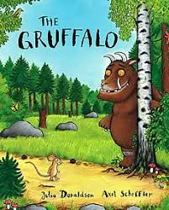



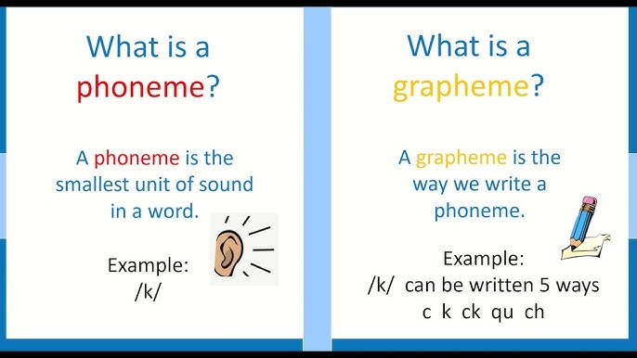
Autumn 1 term Newsletter for Hedgehog Class
Book focus:
Phoneme focus
Maths focuses
Counting songs and rote counting aloud
Comparing objects and numbers.
Counting objects
number recognition
.
The children listen to the phoneme, repeat it, and then match items to the correct grapheme card.
Some will be playing oral blending games such as “touch your l-e-g, what sound does a d-u-ck make? N-o-d your head”
Upcoming dates
African Drumming experience on Thursday 2nd October details to follow.
Themes of the half term:
All About me!
My new class
Life skills e.g. dressing, feeding, cleaning, washing
Who am I ?
Important people

