Slide 1


NHS Speech and Language Therapy (SALT)

Slide 2
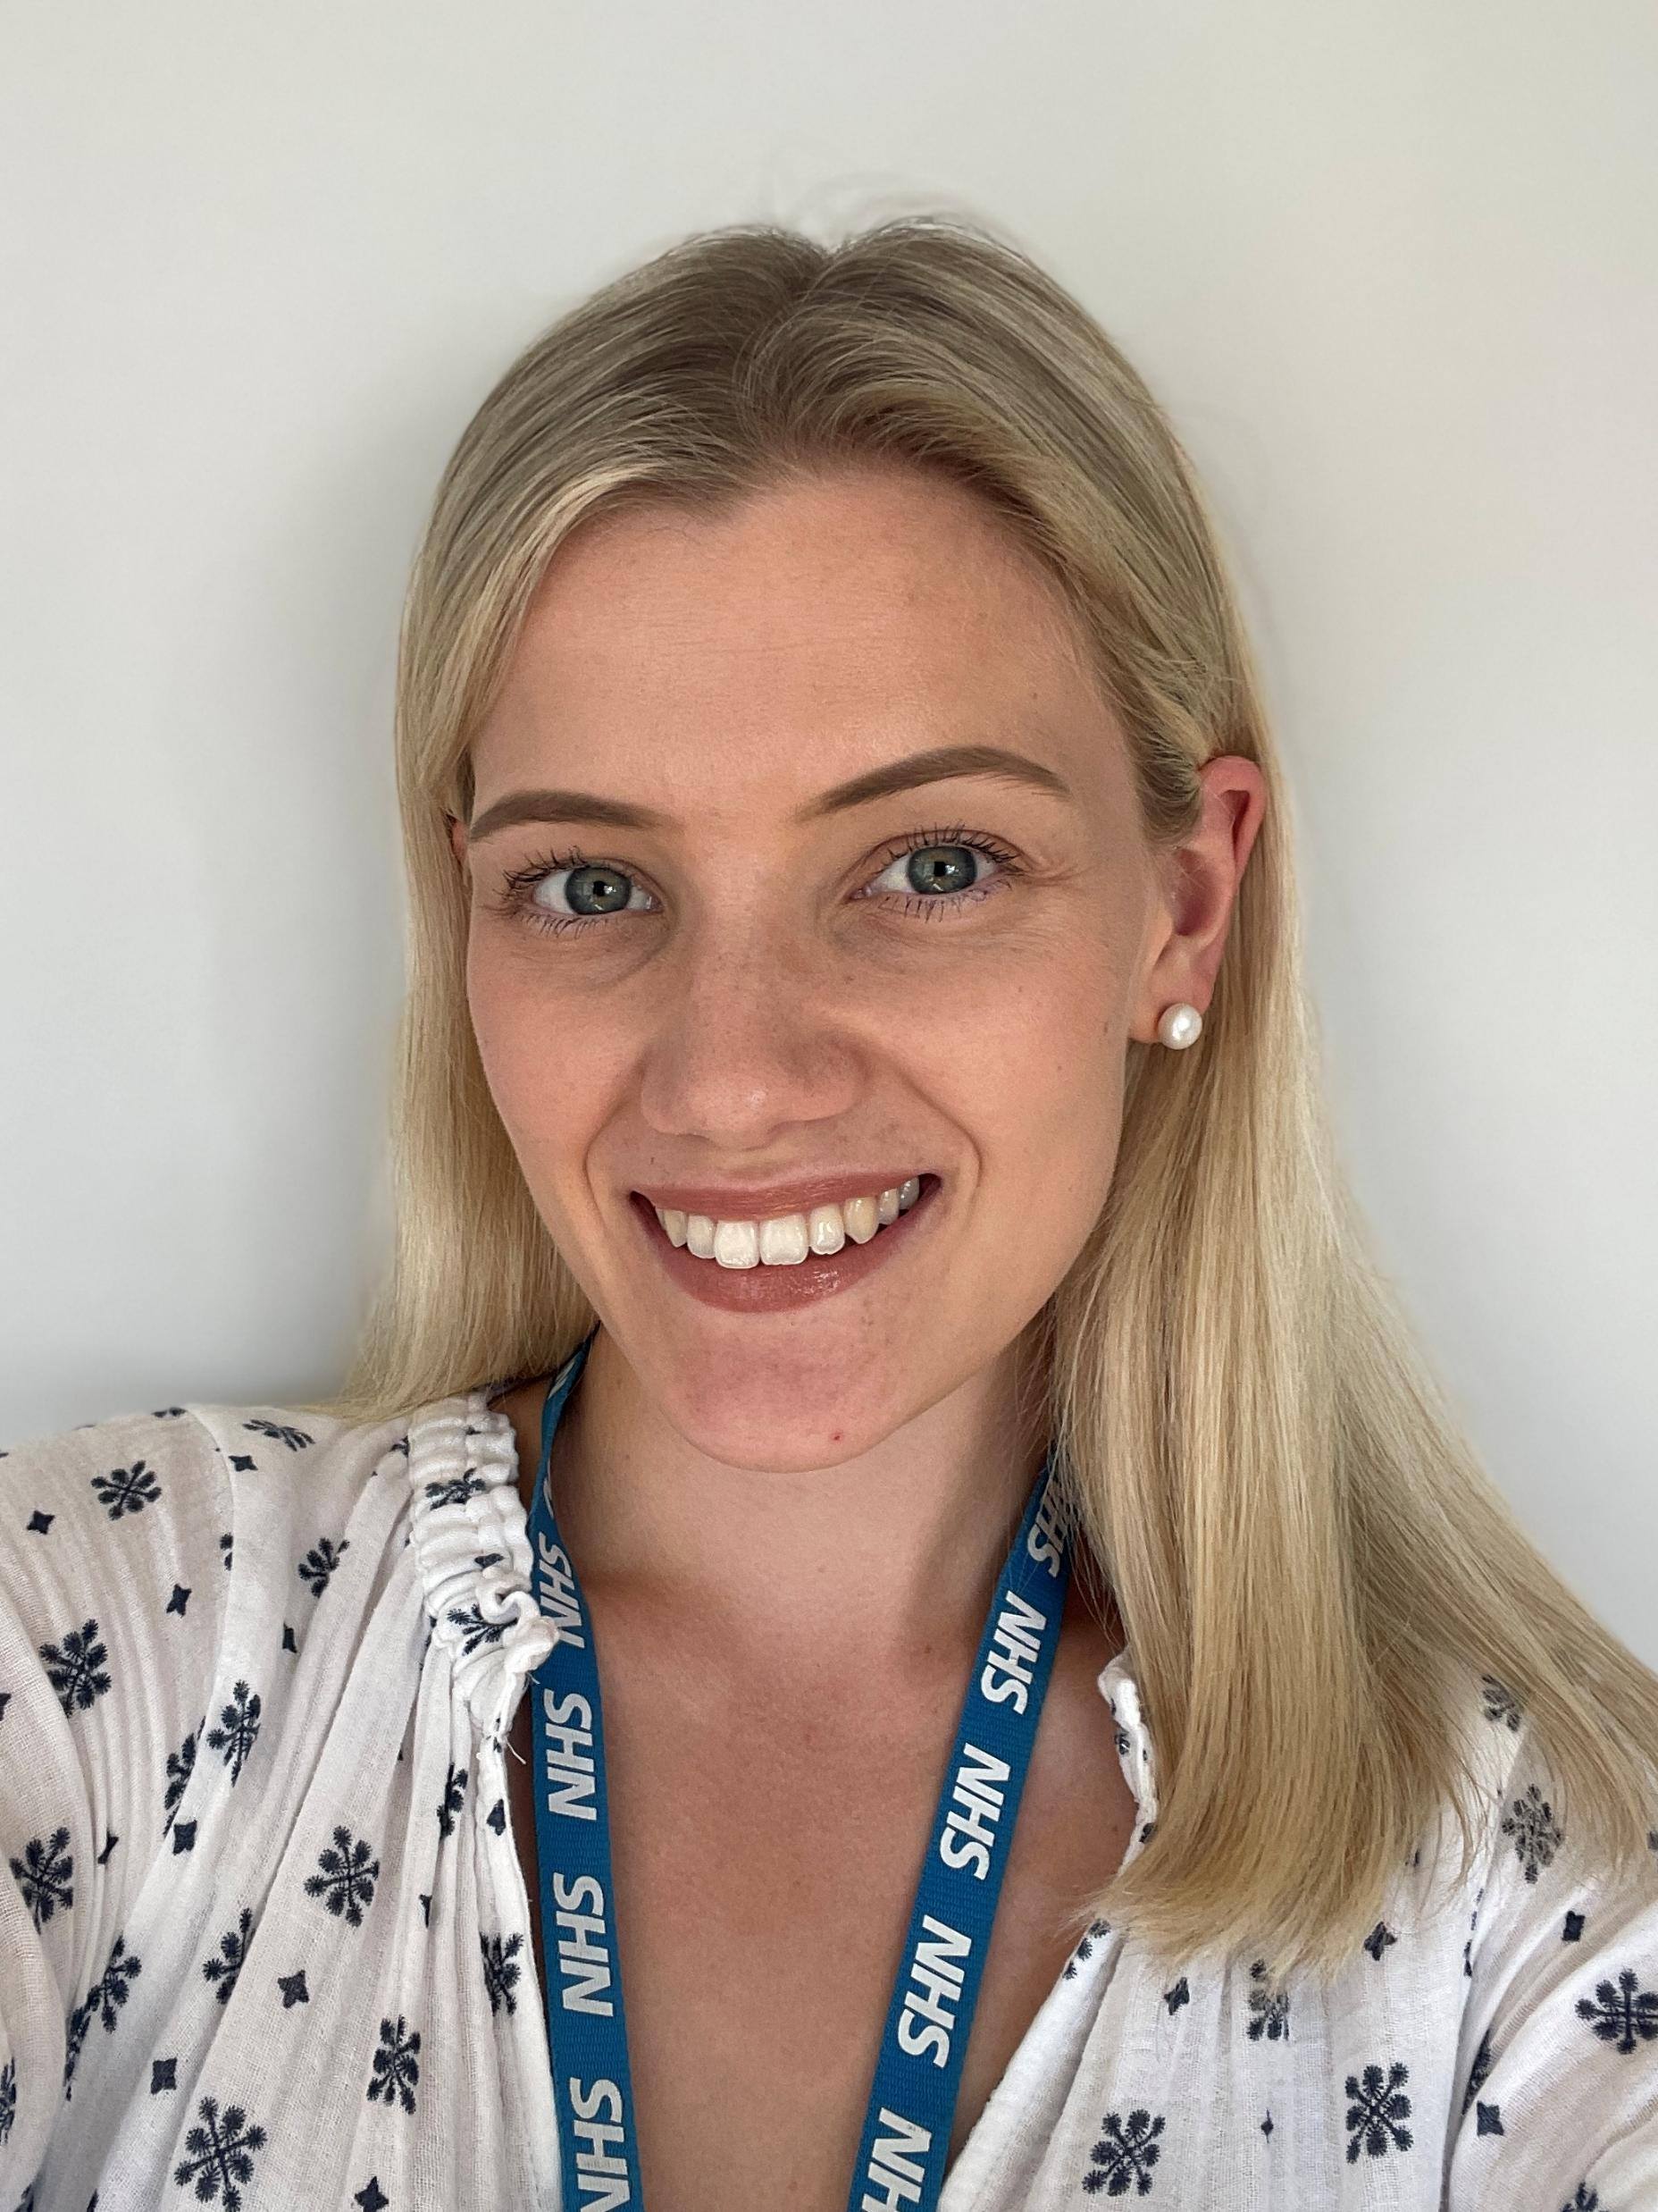
About me
My name is Charlotte Edwards, and I am a Specialist Speech and Language Therapist. I am the designated therapist for Hedgehogs class.
I work across a range of Specialist Support Units (SSUs) in West Suffolk for three days a week, and I spend the remaining two days in a specialist school supporting young people aged 7–16.
I specialise in working with children with additional needs by supporting staff within their environment to use strategies that adapt the classroom and create a total communication-friendly setting.
My aim is to support children to develop a functional means of communication, a way to express their wants and needs effectively.

Slide 3

My role
Outline therapy provision and targets for each child on our caseload, once seen by us.
Work with specialist unit staff supporting the child, demonstrating activities and providing follow up tasks in setting.
Helping to adapt the unit environment to support effective communication
Supporting children to develop a formal means of communication, social interaction + play skills
Provide advice and training where required, facilitating school and parents/carers in supporting a child to maintain their communication skills in their everyday environments.
Provide an EHCP annual review report annually to review progress and update targets and outcomes (when given 4 weeks' notice).
Work with a child until they reach the point at which their communication difficulties can be supported via universal strategies.
Involve parents and advise them of planned assessment / intervention and follow up tasks for home via records of visit.

Slide 4

School’s role
Identify a member of staff ('therapy partner') to work with/ observe the child during all school-based sessions.
Ensure that children practise as recommended by the therapist and that the therapy partner has the required time for resource making and preparation.
Give at least one month's notice of Annual Review dates.
Ensure SALT 'record of visit' sheets are referred to and followed for carry over activities including:
Using strategies consistently
Modelling communication throughout the day
Observing communication attempts and sharing feedback with SALT
Supporting generalisation of skills across contexts
Maintaining visuals/communication systems in the classroom

Slide 5
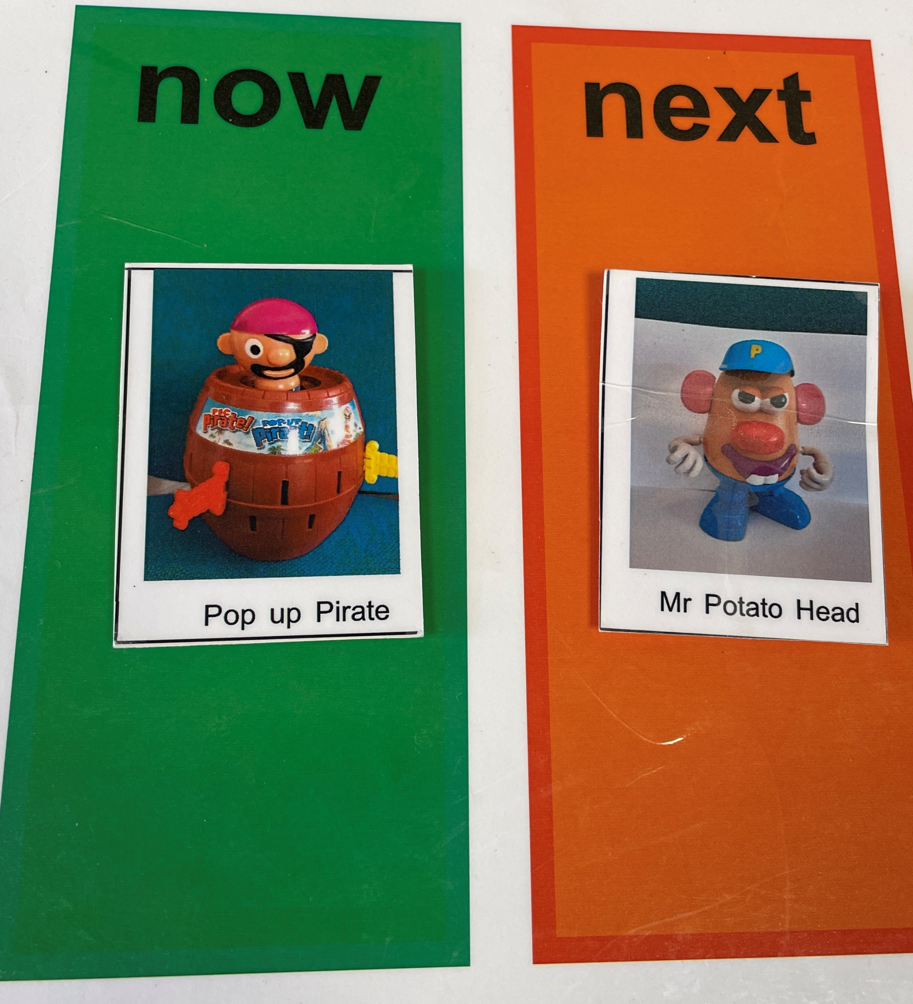
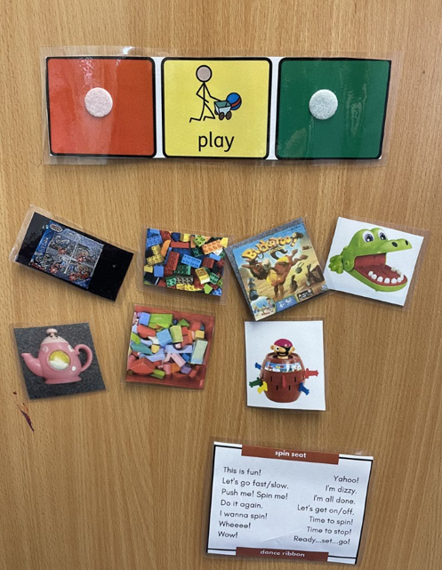
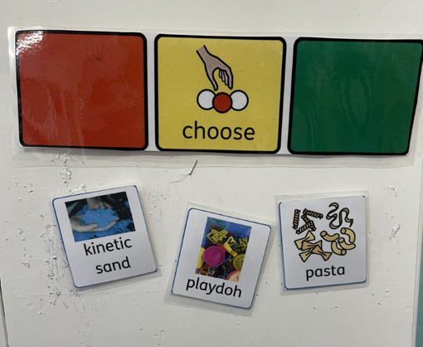
What are we working on in Hedgehogs?
Intensive Interaction – Building early communication through shared play, turn-taking, and joyful exchanges.
Visual Support for Transitions – Symbols, timetables, and pictures to help children understand routines and what's happening next.
Making Choices – Supporting children to show their preferences using pictures, objects, or gestures.
Making Requests (Total Communication) – Encouraging any form of communication: speech, signs, gestures, symbols, or objects.

Slide 6
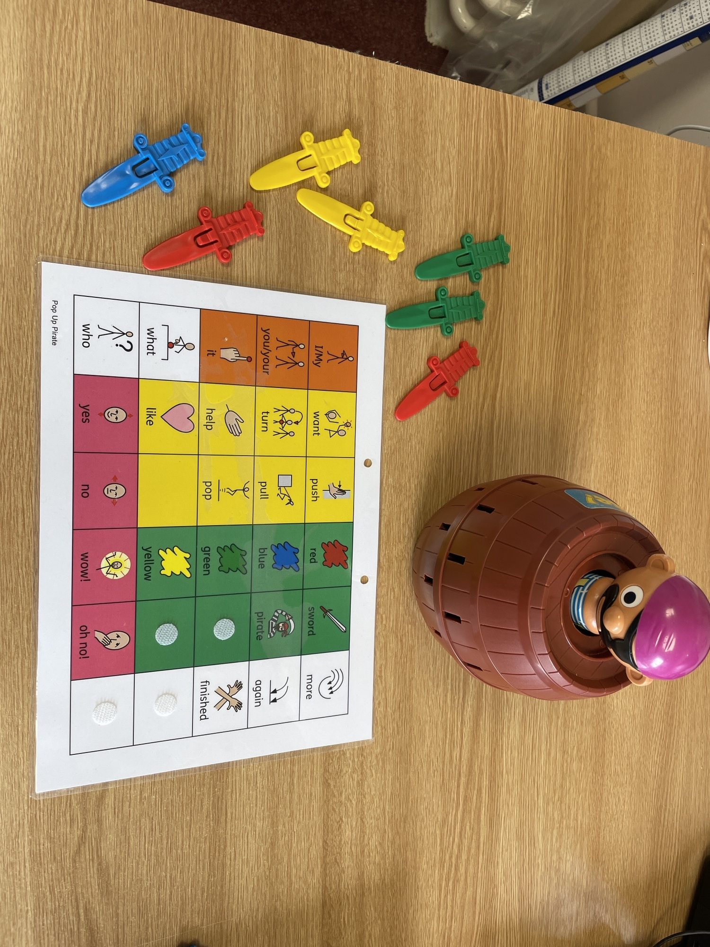
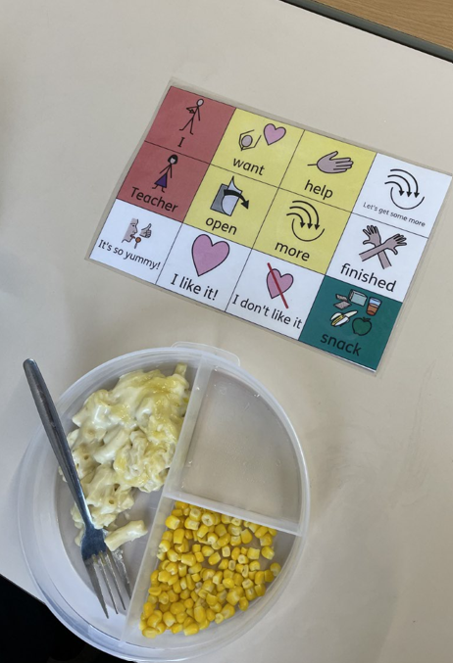
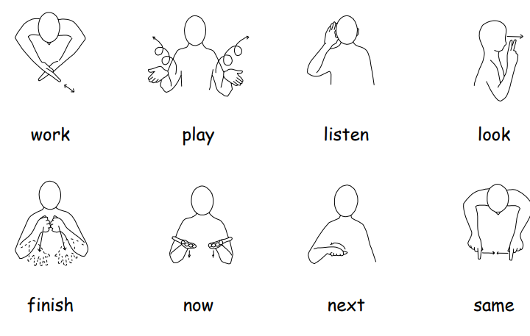
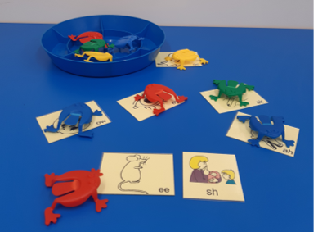
More of what we are working on…
Makaton – Using signs and symbols alongside speech to support understanding and expression.
Using AAC – Communication tools such as symbol boards, books, or devices to help children express themselves.
Attention Building (Attention Bucket) – Highly motivating activities designed to develop shared and focused attention.
Speech Sound Therapy – Activities that help children hear, practise, and produce clearer speech sounds.

Slide 7

How We Support Families of Children with SEND
Sharing communication strategies for home (via records of visit/ email updates)
Providing reports for EHCP reviews
Liaising with parents about goals and progress ahead of an annual review
Signposting to other community services
Helping families understand the child’s communication profile
Encouraging generalisation of communication skills outside school

Slide 8

How to Contact Me
Please read through records of visit shared
Contact me via email regarding your child’s session or progress at home- I always like to hear how they are getting on
Contact me with any communication-based queries
My working days are Monday, Tuesday, Wednesday.
charlotte.edwards@wsh.nhs.uk

